Slide 1

Football (*soccer)MANAGER
“Give me Zidane and 10 pieces of wood, and I will win you the Champions League” - Sir Alex Ferguson

Slide 2
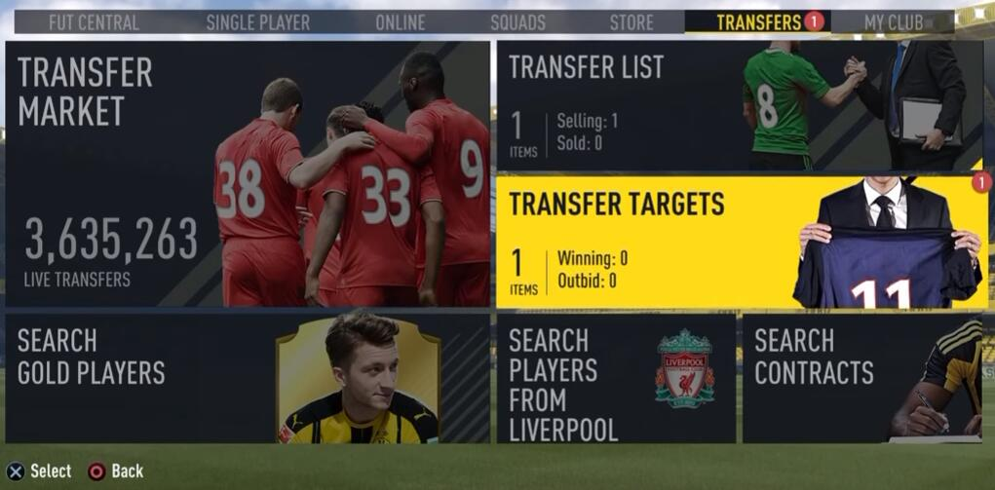
Motivation
Net spending of Europe’s top 5 leagues 6000 million £ in 2018/2019.
Maximize Revenue for outgoing transfers and save money for incoming transfers.
Improve the accuracy of the estimate of player valuation!!

Slide 3

FOOTBALL MANAGER
DEMO
http://3.15.46.92:3000/

Slide 4
data
Data scraped from https://sofifa.com hosted on Kaggle
Detailed attributes for ~18,200 players in the latest edition of EA Sports FIFA19
Attributes include on all player style statistics like Dribbling, Aggression, GK Stills etc
Player personal data like Nationality, Photo, Club, Age, Wage, Salary etc..

Slide 5
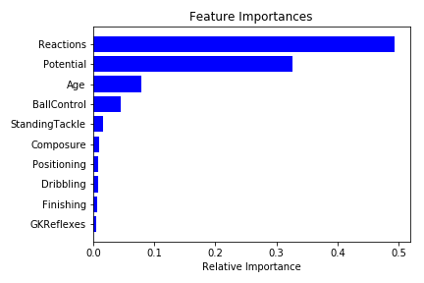
Predictive model
Log-transformed response variable to adjust for skewness
Used linear regression for benchmark & Random forest for feature selection.
KNN to identify similar players
Test data Statistics
R-squared: 95%
Prediction Accuracy: 0.72

Slide 6
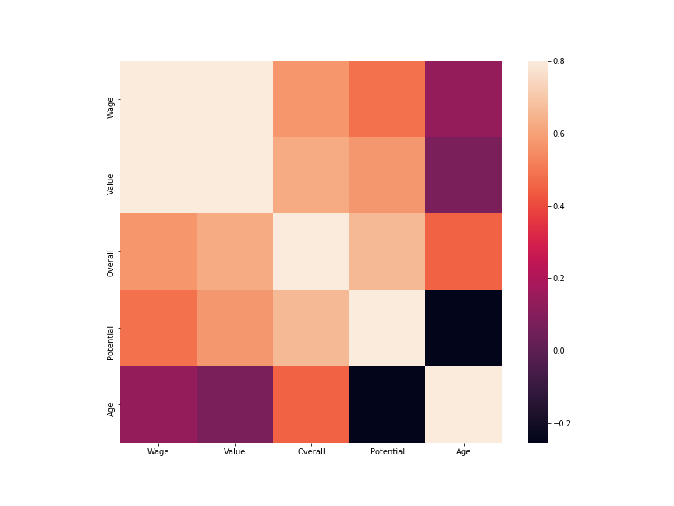
Insights
Estimate player value with reasonably high accuracy using very few features only. (10 out of ~90)
High correlation between Market value, Player Salary and Overall rating.

Slide 7
THANK YOU!
Arpan Venugopal
arpanvenugopal2019@u.northwestern.edu

